Slide 1

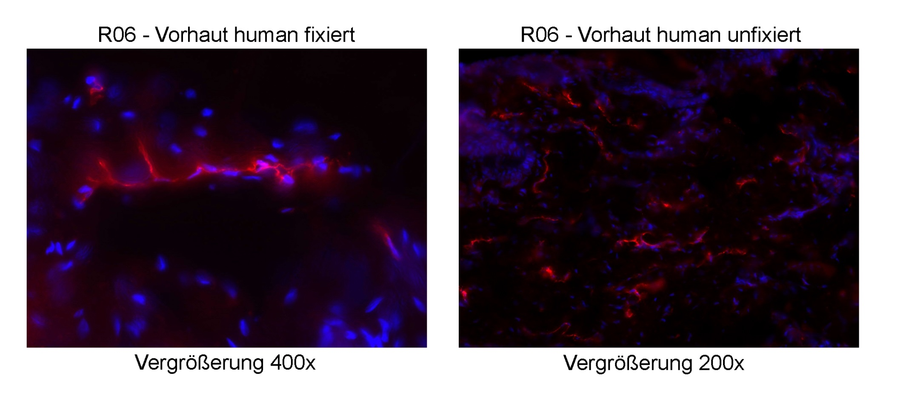
ReliaTech GmbH
Rabbit anti-human LYVE-1
(Cat #102-PA50; K5577; Prot-A)
K22973
K22974
Immunofluorescence staining (red) of cryo-sections of human foreskin (fixed / unfixed) with anti-human LYVE-1 (5µg/ml) [Cat# 102-PA50] and counter staining of nuclei with Dapi (blue).
The experiment was performed by the research group of Prof. Dr. J. Wilting and Dr. K. Buttler, University Göttingen, Germany.
http://www.reliatech.de / orders@reliatech.de

